Slide 1
AM 5.5 6 6.5. 7 8 9 11 13 15 17
FM 88 90 92 94 96 100 102 104 108
SW 6 7 8 9 10 12 14 16 18
|….|….|….|….|….|….|….|….|….|

Slide 2
. 53 60 70 80 100 120 140 160 .
. 88 90 92 94 96 100 102 104 108 .
AM
*
Billy’s
Crystal Radio
FM
*
Billy’s
Crystal Radio
Print using handout with 4 slides per page

Slide 3
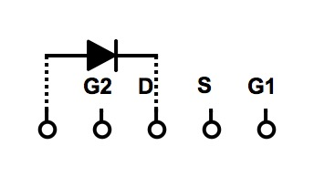
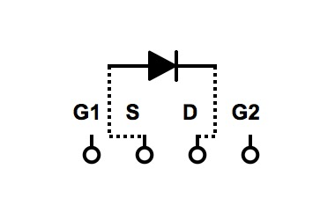
Billy’s double tuned AM FM Crystal Radio
. 53 60 70 80 100 120 140 160 .
Antenna
AM1 FM1 GND FM2 AM2
Headphone
AM FM
88 90 92 94 96 98 100 102 104 106 108
Billy’s
Double Tuned
AM FM
Crystal Radio
AM
FM

Slide 4
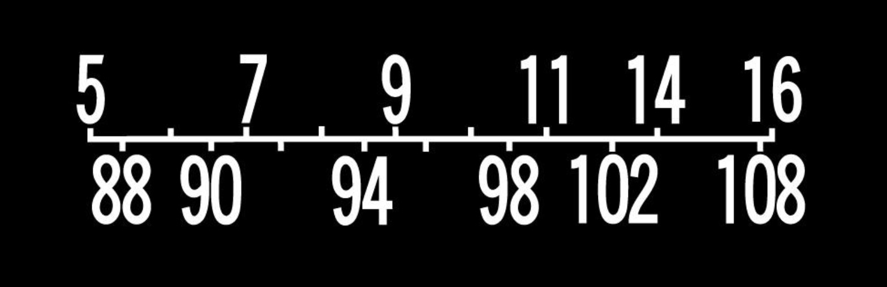
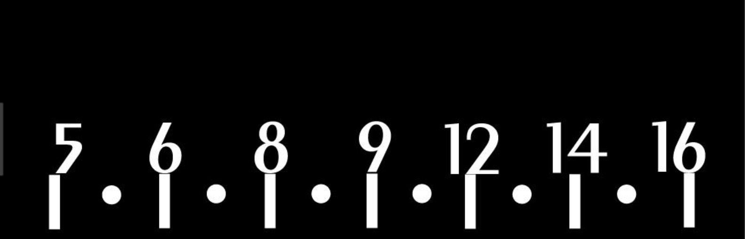
FM
AM

